Slide 1



UNIT 1
LESSON 3
ALL THAT GLITTERS
Part 1

Slide 2
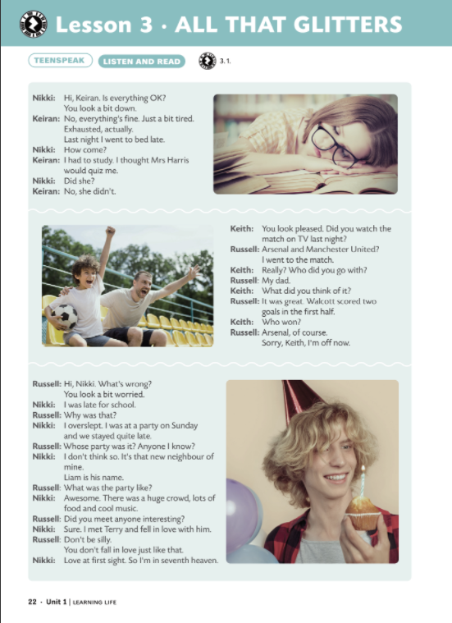


The weekend is…
Keiran looks a bit down.
Russell looks pleased.
Nikki looks a bit worried.

Slide 3
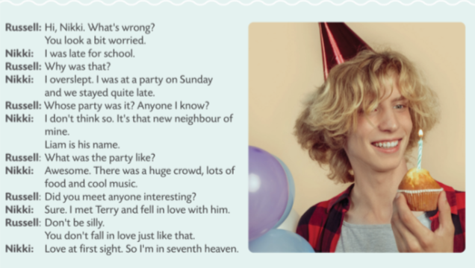
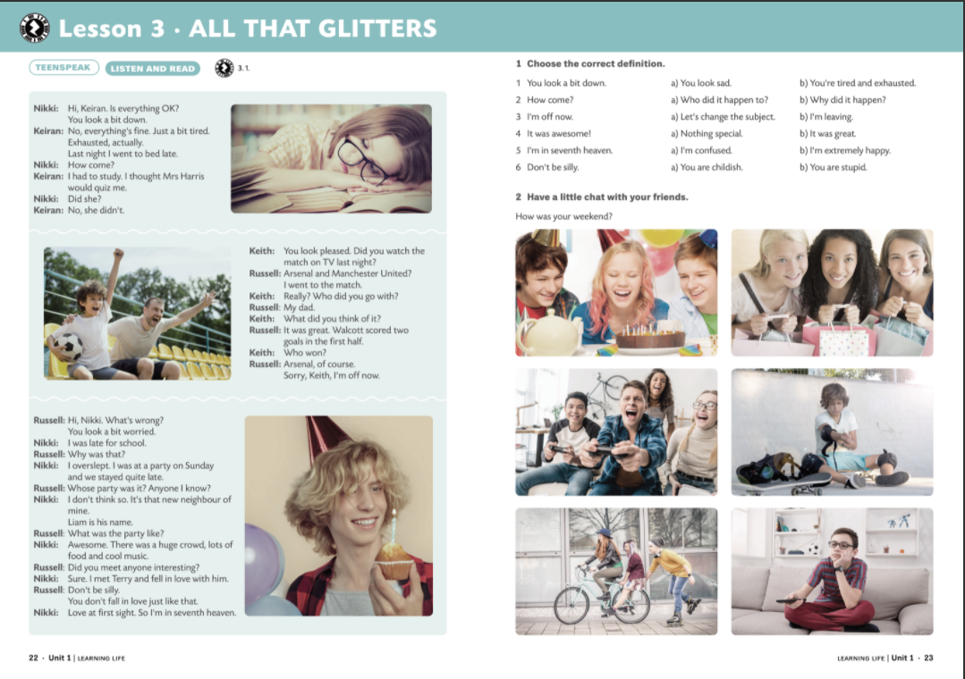
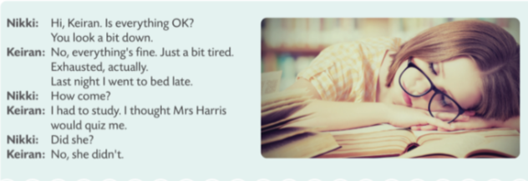
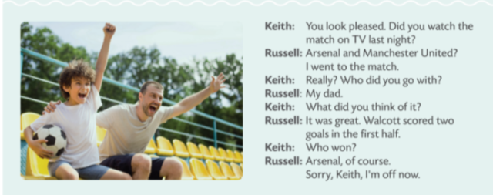

Slide 4
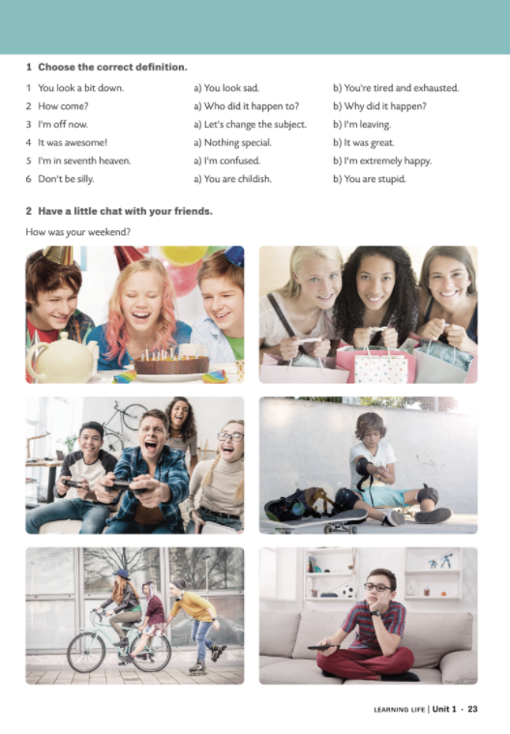
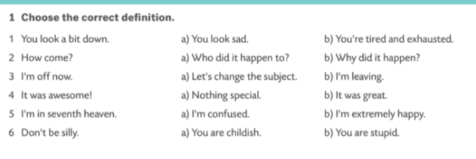


Slide 5
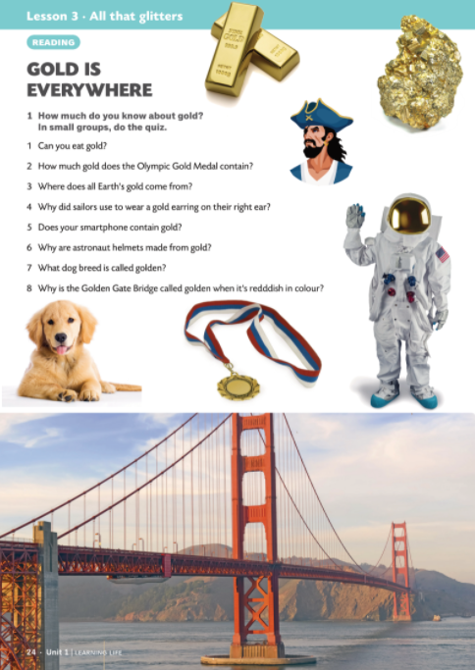

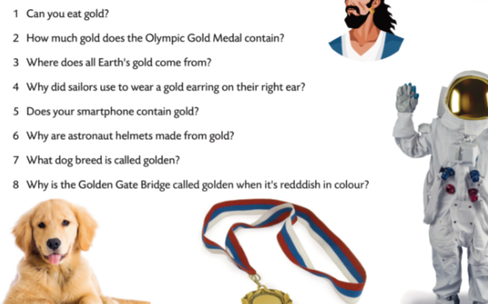


Slide 6
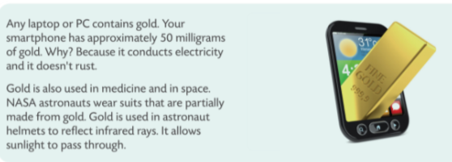
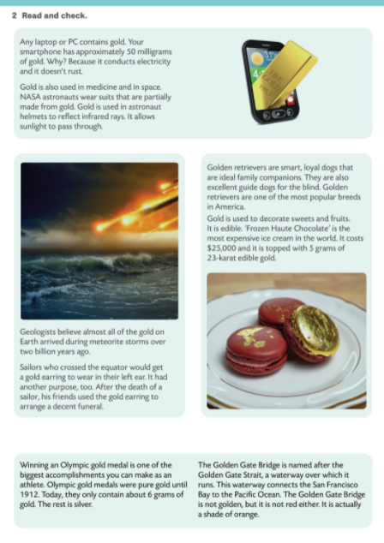
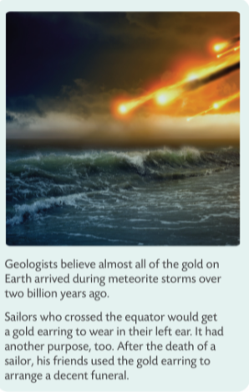
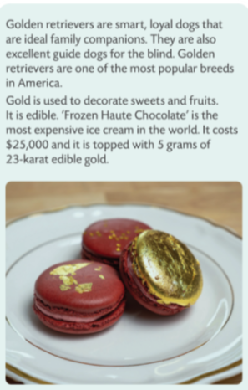
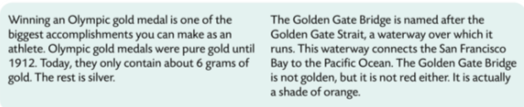
YES
6 GRAMS
THE SPACE
After the death of a sailor.
Yes, about 50 milligrams.
To reflect infrared lights. It allows sunlight to pass through.
Golden retrievers.
It is named after the Golden Gate Strait.

Slide 7
Daleko od očiju, daleko od srca.
Tko se zadnji smije, najslađe se smije.
Tko rano rani, dvije sreće grabi.
Nije zlato sve što sja.
Out of sight, out of mind.
He who laughs last, laughs longest.
The early bird catches the worm.
All that glitters is not gold.

